Slide 1
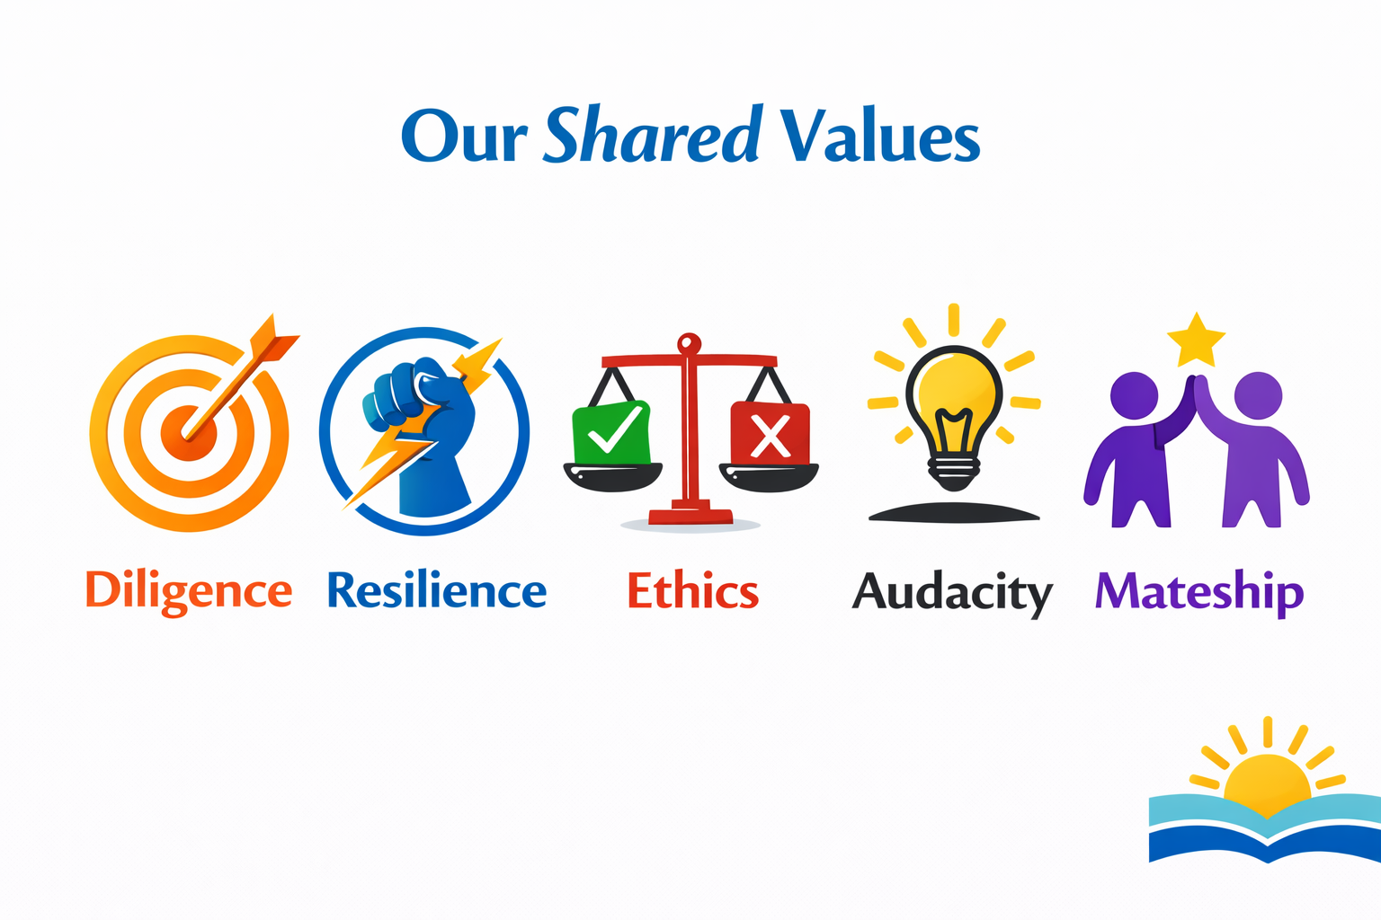

Welcome back
Darling Point Special School 2026
Good to Great
incorporating Grace, Hope and Shared Values

Slide 2


Slide 3
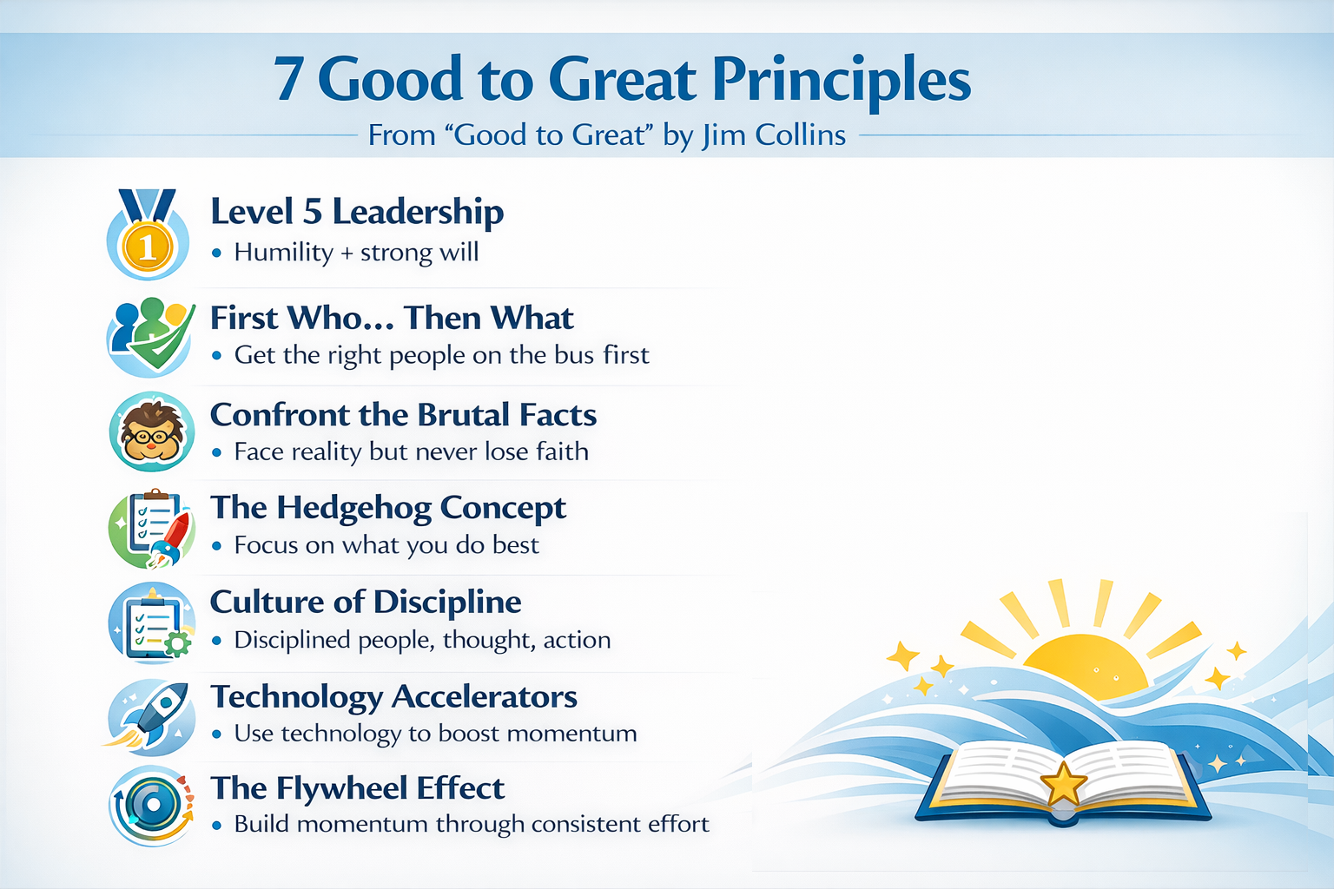
Notes:
Good to Great
Key points from Good to Great (Jim Collins)
1) Level 5 Leadership
The best leaders combine personal humility with professional will. They put the organisation first, not their ego.
2) First Who… Then What
Great organisations get the right people on the bus, the wrong people off, and the right people in the right seats, before deciding the direction.
3) Confront the Brutal Facts (but never lose faith)
Great teams face reality honestly (even when it’s uncomfortable), while maintaining confidence they will succeed in the end.
4) The Hedgehog Concept
Sustained greatness comes from focus on the overlap of:
what you’re deeply passionate about
what you can be best in the world at
what drives your results/economic engine
5) A Culture of Discipline
Great organisations don’t rely on constant motivation. They build disciplined people and disciplined thinking, so high performance becomes “how we do things”.
6) Technology Accelerators (not technology creators)
Great organisations use technology to speed up momentum, not as a “magic fix” or starting point.
7) The Flywheel Effect (not the Doom Loop)
Transformation is usually not one big breakthrough. It’s consistent effort over time, building momentum until results compound.

Slide 4


Slide 5
As we grow from Good to Great to even Greater … (Ben Crowe … Mojo Crowe)
Reflect and choose your attitude – who do I see in the mirror?
Picot your perspective, open to evidence
Encourage connections and belonging – remember that talking quickly interrupts learning
Prioritise connection and meaning over external definitions of success
What is my currency? That of my colleagues? Students?
Opinions based on fact not emotions
Check for meaning – our own and others; Have courage, don’t be hard on ourselves or others
Am I a comfortable hearer or a transforming doer? Do I search for meaning, truly listen, absorb detail?
Let go of what you cannot control
Recognise the benefits of being vulnerable and the freedom that comes from it
Beware of assumptions but be generous when making assumptions
Remember, you are enough … as none of us is done yet!
Think about the human ‘’You’’ and where that thought takes you (Being not doing …)

Slide 6
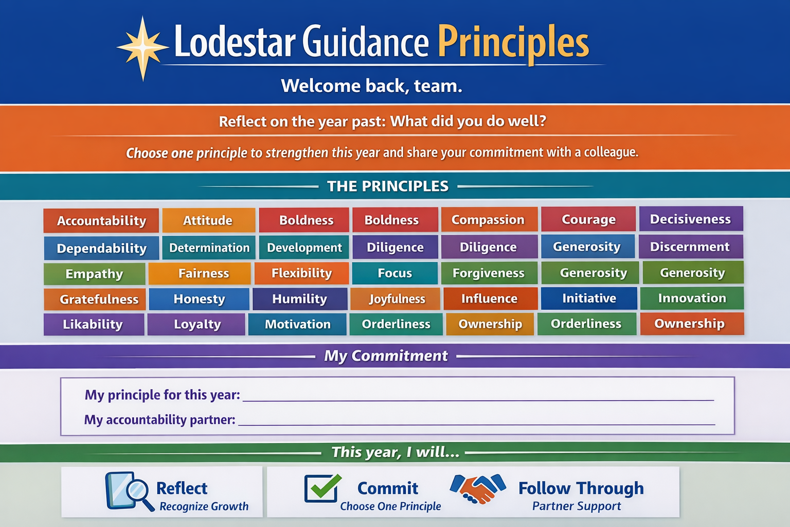

Slide 7
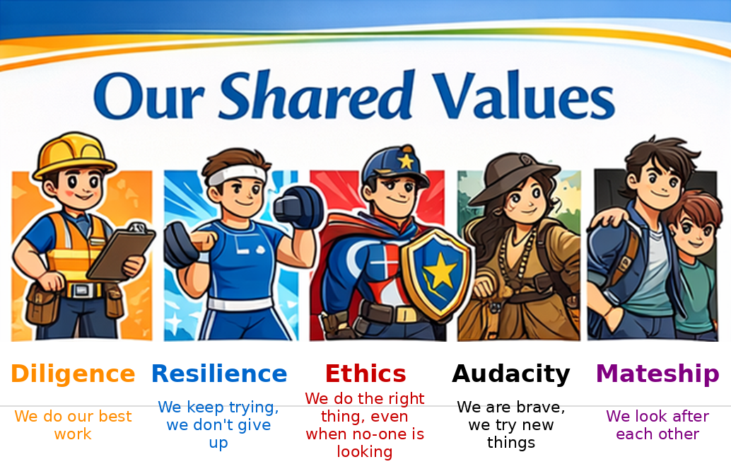

Slide 8
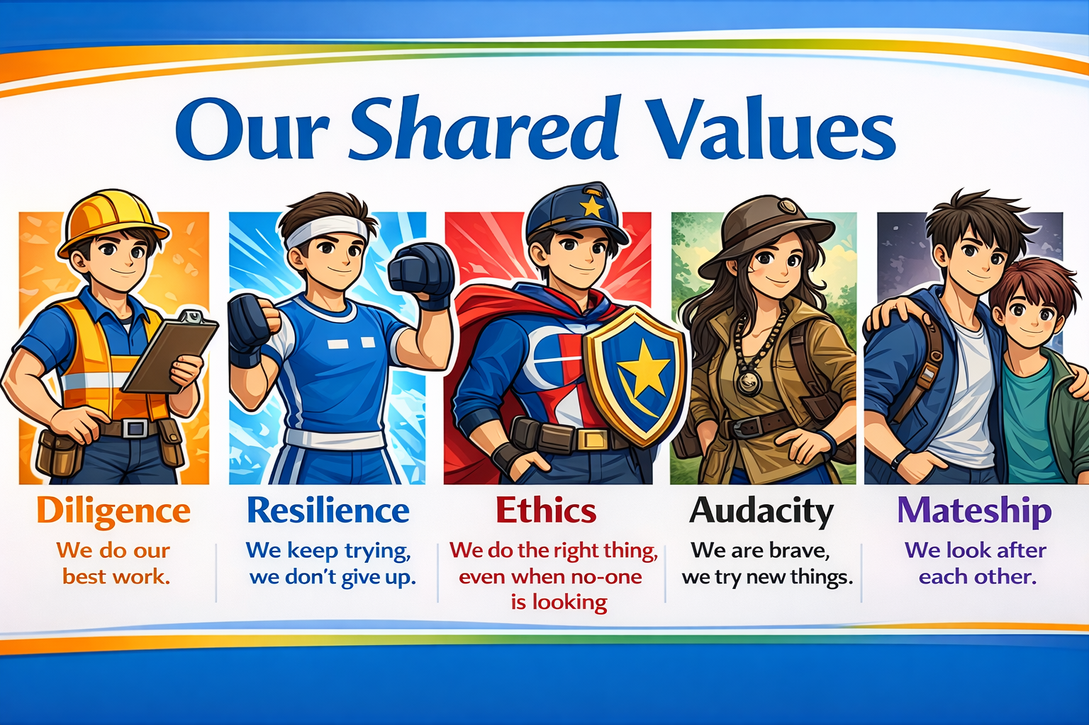

Slide 9
